Slide 1
Reservation System
Project created by
Luke Parker
Lauren Young

Slide 2
Project Overview
A restaurant just added some locations, so it needs a way to manage reservations for multiple locations.
The hostess needs to be able to create, cancel, or update reservations.
Also, if the location is at capacity, or the reservation is scheduled outside of normal operating hours, then the reservation should not be allowed to be made.

Slide 3
Overcoming Challenges
Checking capacity against already existing reservations
Efficiency of code for database scalability
Using the DateTime and Timespan data types with JSON
Filtering Queries to allow user friendly searching

Slide 4
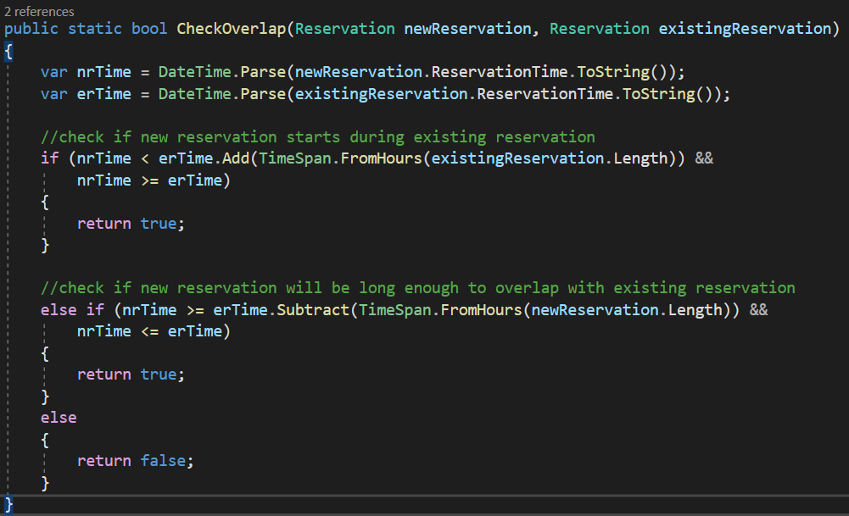
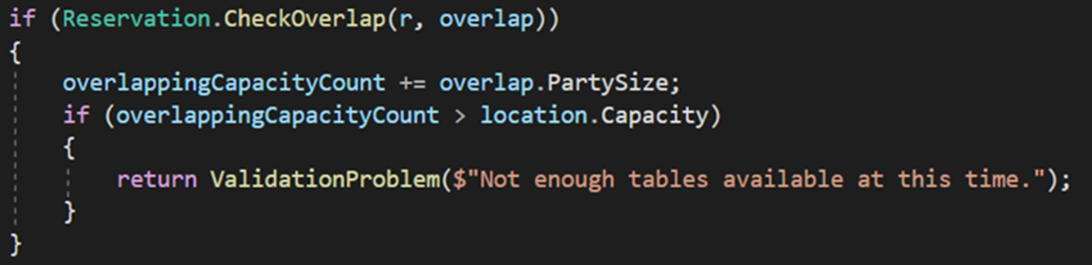
CheckOverlap Method
Developed logic to check if two reservations overlapped
Encapsulated in method for easy reuse.

Slide 5
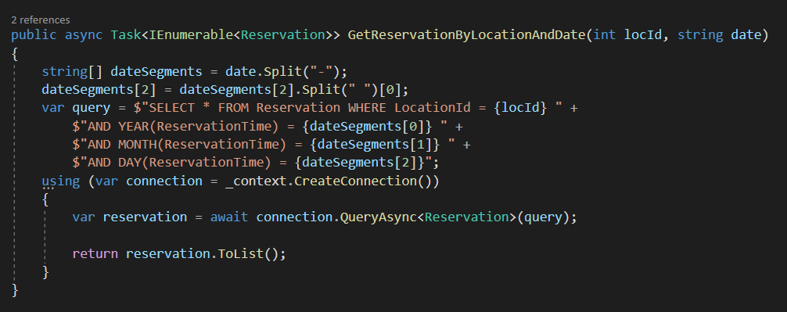
Considering Database Efficiency
Created a method to retrieve Reservations for a Location and a specific Date
Allows the CheckOverlap method to pull smaller data sections to reduce lag as database scales up in size

Slide 6
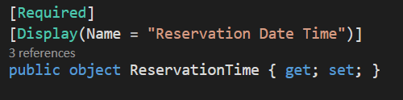
Data Types with JSON
SQL and C# both have DateTime and TimeSpan data type.
The API passes through JSON which does not have those data types.
Our solution is to make those “object” data types initially.
We then parse the data from the object into a DateTime (or TimeSpan) data type

Slide 7
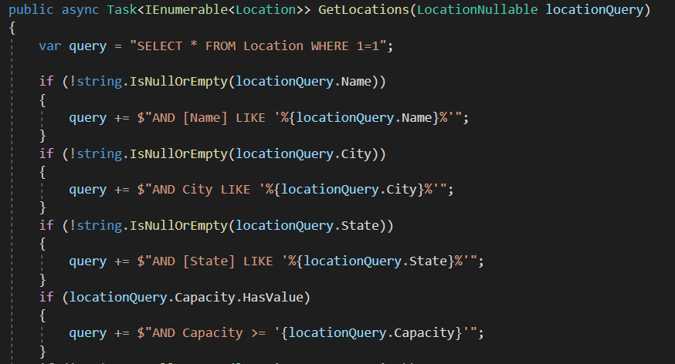
Query Filtering
Adapting null check for different (sometimes not nullable) data types
Refactored code to allow more user friendly filtering, factoring in what they would expect from a given parameter.

Slide 8
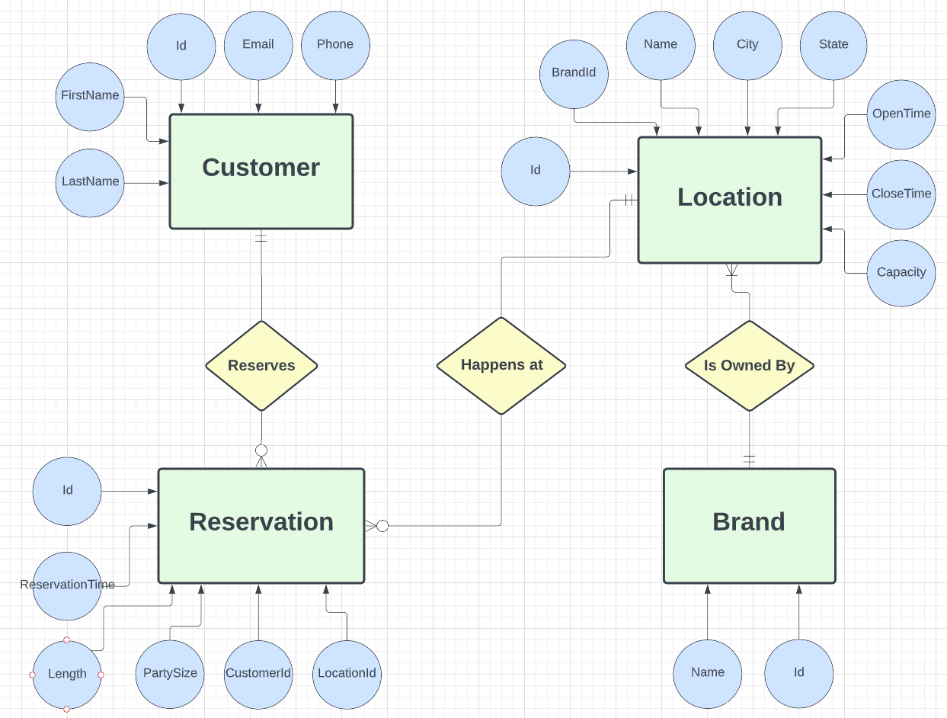
Entity Relationship Diagram

Slide 9
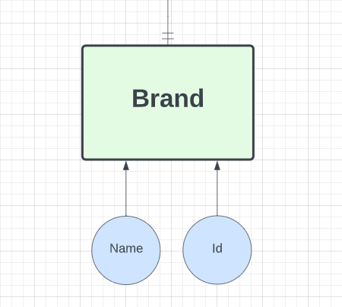
Brand
Attributes
Id
Name
Constraints
Must own at least one or more Locations
Exists in case this technology expands to include multiple brands

Slide 10
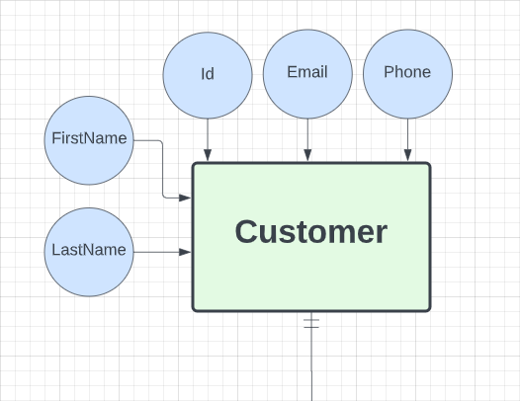
Customer
Attributes
Id
FirstName
LastName
Phone
Email
Constraints
Can have 0 or many Reservations

Slide 11
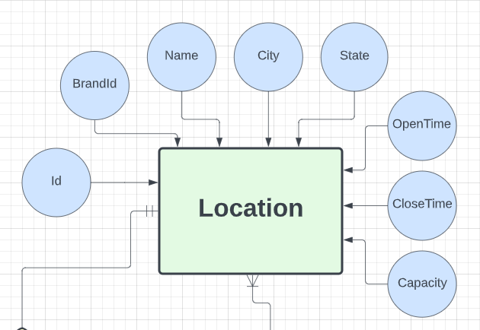
Location
Attributes
Id
Name
Street
City
Capacity
OpenTime
CloseTime
Constraints
Location must have 1 and only 1 Brand
Location may have 0 or more Reservations

Slide 12
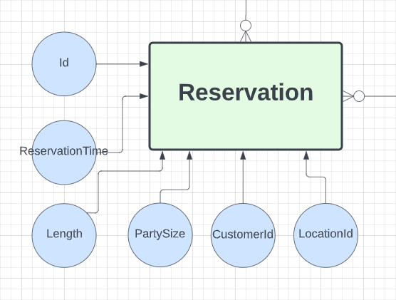
Reservation
Attributes
Id
Length
PartySize
ReservationTime
CustomerId
LocationId
Constraints
Must have 1 and only 1 Customer
Must have 1 and only 1 Location

Slide 13
Use Cases
You get a call from a Brand manager notifying you of a new construction nearing completion. They want you to add the new Location to the system so they can begin taking reservations soon.
A Customer calls and wants to cancel their existing Reservation. They would like to make a new Reservation at a different date and Location. You can either delete and recreate the Reservation or update the existing Reservation.
Industry potential
Dental Offices
Gym Classes
Appointment Driven Services

Slide 14
Now for a demonstration…

Slide 15
Where Do We Go From Here?
Potential Expansions to Product Functionality
Search Brands by service type
Expand Customer class to include more data
Give ability to check table availability separate from building capacity

